Slide 1
Azure Data Platform Implement Real Time Analytics in a Modern Data Platform Architecture
This lecture has been adapted from the Microsoft workshop on the Azure Data Platform End-to-End
Nishan Mills
Technical Architect – Centre for Data Analytics and Cognition
N.Mills@latrobe.edu.au

Slide 2
Lecture Objectives
We will understand Cloud and Big Data concepts and technologies used to solve the most common advanced analytics problems
We will understand the role of Microsoft Azure data services in a modern data platform architecture
We will look at a practical implementation of a real time analytics use case built with Microsoft Azure components.

Slide 3
Disclaimer
The Azure services covered in this course are only a subset of a much larger family of data services. Some real-world data scenarios may require the use of services not included in this course.
This lecture does not replace in-depth training on each Azure service covered today.
Some concepts presented in this course can be quite complex and you may need to seek for more information from different sources.

Slide 4
Modern Data Platform Reference Architecture

Slide 5
The Big Picture

Slide 6
The modern data world out there

Slide 7
The modern data estate
LOB
CRM
Graph
Image
Social
IoT
Hybrid
Operational databases
Operational databases
Data warehouses
Data warehouses
Data lakes
Data lakes
Reason over any data, anywhere
Flexibility of choice
Security and performance

Slide 8
The Microsoft offering
LOB
CRM
Graph
Image
Social
IoT
Hybrid
Easiest lift and shift with no code changes
SQL Server
Azure Data Services
Industry leader 4 years in a row
Operational databases
Operational databases
70% faster
#1 TPC-H performance
Data warehouses
Data warehouses
2x the global reach
T-SQL query over any data
Data lakes
Data lakes
99.9% SLA
AI built-in | Most secure | Lowest TCO
Reason over any data, anywhere
Flexibility of choice
Security and performance
Notes:
Your data estate is your springboard for innovation.
these new products and services make up the Microsoft data platform
Our cloud-first approach means we work continuously to bring you:
reason over any data
Flexibility of choice
security and performance
Microsoft provides the best location for nurturing innovation today and into the future.
We’re investing in your success. So go ahead and work your magic.

Slide 9




The Azure data landscape
SQL
Azure Data Factory
Azure Import/Export service
Azure SQL DB
Azure Cosmos DB
Azure Synapse Analytics
Azure Analysis Services
Power BI
>_
Azure CLI
Azure SDK
10 01
Azure Blob Storage
Azure Data Lake Store
Azure HDInsight
Azure
Databricks
Azure ML
ML Server
Azure
Databricks
Azure IoT Hub
Azure event hubs
Azure Search
Azure Data Catalog
Azure Stream
Analytics
Azure HDInsight
Azure
Databricks
Bot service
Cognitive services
Kafka on Azure HDInsight
NSG
Azure ExpressRoute
Azure Active Directory
Azure network
security groups
Azure key
management service
Operations
Management Suite
Azure Functions
Visual Studio
Notes:
Explain that there is a number of data services available, each with their distinctive capabilities and use cases. No need to provide detailed explanation of each services as most of them will be covered in the following slides.

Slide 10
The Azure Big Data landscape
SQL
Azure Data Factory
Azure Import/Export service
Azure SQL DB
Azure Cosmos DB
Azure Synapse Analytics
Azure Analysis Services
Power BI
>_
Azure CLI
Azure SDK
10 01
Azure Blob Storage
Azure Data Lake Store
Azure HDInsight
Azure
Databricks
Azure ML
ML Server
Azure
Databricks
Azure IoT Hub
Azure event hubs
Azure Search
Azure Data Catalog
Azure Stream
Analytics
Azure HDInsight
Azure
Databricks
Bot service
Cognitive services
Kafka on Azure HDInsight
NSG
Azure ExpressRoute
Azure Active Directory
Azure network
security groups
Azure key
management service
Operations
Management Suite
Azure Functions
Visual Studio

Slide 11
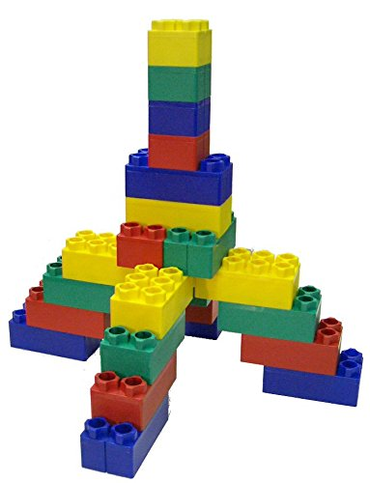
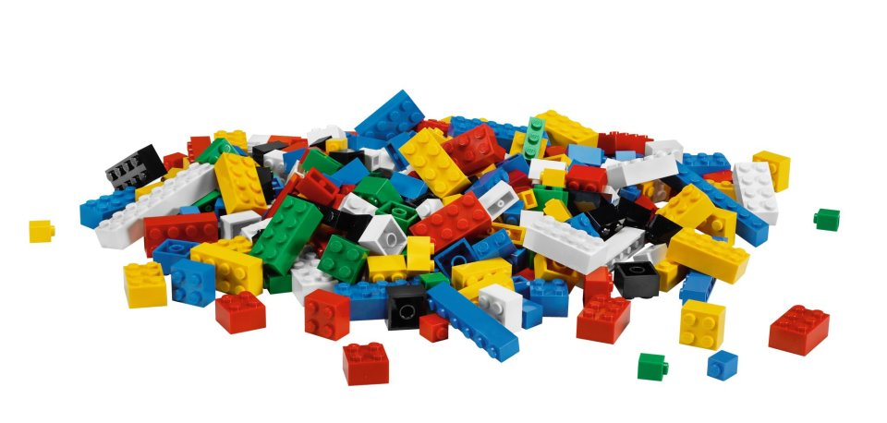
Our job, pretty much

Slide 12
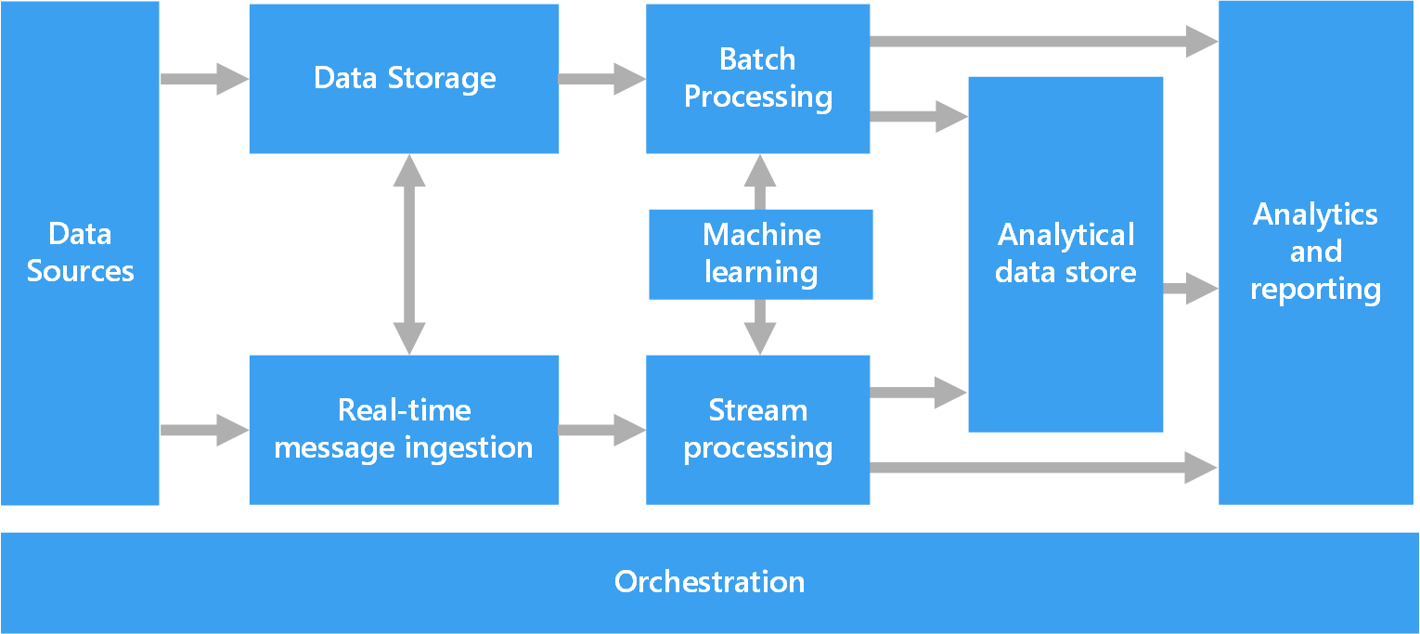
Azure Data Architecture Guide
Valuable collection of architecture principles to help you with your technology choices
https://aka.ms/adag

Slide 13
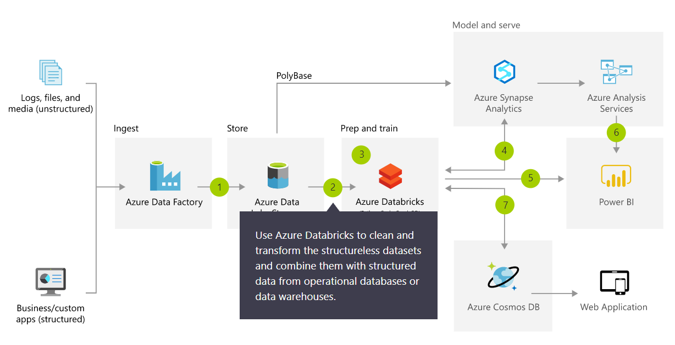
Azure Architecture Solutions
Collection of reference architectures for most common challenges
https://azure.microsoft.com/en-us/solutions/architecture/

Slide 14
Modern Data Platform Solution Scenarios
Big Data and advanced analytics
SQL
Modern data warehousing
Advanced analytics
Real-time analytics
“We want to integrate all our data—including Big Data—with our data warehouse”
“We’re trying to predict when our customers churn”
“We’re trying to get insights from our devices in real-time”

Slide 15
IaaS vs PaaS vs SaaS
On Premises
Physical / Virtual
Infrastructure
as a Service (IaaS)
Platform
as a Service (PaaS)
Software
as a Service (SaaS)
You manage
Applications
Applications
Applications
Applications
You scale, make resilient and manage
You scale, make
resilient & manage
Data
Data
Data
Data
Runtime
Runtime
Runtime
Runtime
Scale, Resilience and management by Microsoft
Middleware
Middleware
Middleware
Scale, Resilience and management by Microsoft
Middleware
O/S
O/S
O/S
O/S
Virtualization
Virtualization
Managed by Microsoft
Virtualization
Virtualization
Servers
Servers
Servers
Servers
Storage
Storage
Storage
Storage
Networking
Networking
Networking
Networking
Azure
Virtual Machines
Azure
Cloud Services

Slide 16
What is a Data Warehouse?
A data warehouse is a large collection of business data used to help an organization make decisions. Data in the Data Warehouse has been identified as valuable to specifically defined business cases and is stored in a structured way readily available for reporting and data analysis.
It is not an Operational Database
Different workload types: transactional (DB) versus analytics (DW)
It is not a Data Lake
These are different concepts, they can co-exist and they compliment each other
It is not a Data Mart
A data mart is a subject-oriented database populated from a subset of the Data Warehouse
Notes:
Characteristics

Slide 17
Modern Data Warehousing

Slide 18
Modern data warehousing
The modern data warehouse extends the scope of the data warehouse to serve Big Data that’s prepared with techniques beyond relational ETL
SQL
Modern data warehousing
Advanced analytics
Real-time analytics
“We want to integrate all our data—including Big Data—with our data warehouse”
“We’re trying to predict when our customers churn”
“We’re trying to get insights from our devices in real-time”

Slide 19
Modern data warehousing pattern
LOB
CRM
INGEST
STORE
PREP
MODEL & SERVE (& store)
BI + Reporting
Graph
Advanced Analytics
Image
Social
Data orchestration and monitoring
Big data store
Transform & Clean
Data warehouse
AI
IoT
Cloud
Notes:
Slide objectives:
- Explain that the pattern (ingest, store, prepare and model&serve) is consistent. It is going to be applied using different technologies depending on the data scenario.

Slide 20
SQL Server and Azure SQL Database

Slide 21
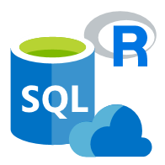
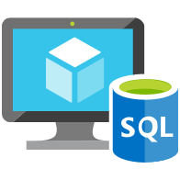
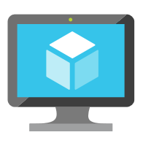
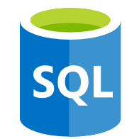
Data platform continuum
PaaS & SaaS
Azure SQL Database
Virtualized Database
Shared lower cost
IaaS
SQL Server in Azure VM
Virtualized Machines
Virtual
SQL Server Private Cloud
Virtualized Machine + Appliance
Physical
SQL Server
Physical Machine (raw iron)
Dedicated higher cost
Higher administration
Lower administration
Notes:
Objective: One of the first things to understand in any discussion of Azure versus on-premises SQL Server databases is that you can use it all. The Microsoft data platform leverages SQL Server technology and makes it available across physical on-premises machines, private cloud environments, third-party hosted private cloud environments, and public cloud. This enables you to meet unique and diverse business needs through a combination of on-premises and cloud-hosted deployments, while using the same set of server products, development tools, and expertise across these environments.
Talking Points:
As seen in the diagram, each offering can be characterized by the level of administration you have over the infrastructure (on the X axis), and by the degree of cost efficiency achieved by database level consolidation and automation (on the Y axis).
When designing an application, four basic options are available for hosting the SQL Server part of the application:
SQL Server on nonvirtualized physical machines
SQL Server in on-premises virtualized machines (private cloud)
SQL Server in Azure Virtual Machine (public cloud)
Azure SQL Database (public cloud)

Slide 22
SQL Server 2019 big data, analytics, and AI
Data virtualization
Managed SQL Server, Spark, and data lake
Complete AI platform
Admin portal and management services
Integrated AD-based security
Analytics
T-SQL
Apps
REST API containers for models
SQL Server External Tables
SQL Server
Spark
SQL Server
ML Services
Spark & Spark ML
Compute pools and data pools
Scalable, shared storage (HDFS)
Open database connectivity
NoSQL
Relational databases
HDFS
External data sources
HDFS
Combine data from many sources without moving or replicating it
Scale out compute and caching to boost performance
Store high volume data in a data lake and access it easily using either SQL or Spark
Management services, admin portal, and integrated security make it all easy to manage
Easily feed integrated data from many sources to your model training
Ingest and prep data and then train, store, and operationalize your models all in one system
Notes:
Amit to cover

Slide 23
Azure SQL Database deployment option
Azure SQL Database
Single
Elastic Pool
Managed Instance
Database-scoped deployment option with predictable workload performance
Shared resource model optimized for greater efficiency of multi-tenant applications
Instance-scoped deployment option with high compatibility with SQL Server and full PaaS benefits
Best for apps that require resource guarantee at database level
Best for SaaS apps with multiple databases that can share resources at database level, achieving better cost efficiency
Best for modernization at scale with low friction and effort
General Purpose
Service Tiers
Business Critical
Hyperscale
Serverless
Notes:
Overview: Azure SQL Database provides you with several deployment options to meet your workload needs. It’s the same SQL engine for all these options.
Talking Points:
There are three hosting options available in Azure SQL Database:
Each standalone database is assigned a certain amount of resources via performance tiers: Basic, Standard, and Premium. The emphasis of this offering focuses on a simplified database-scoped programming model and applications with a predictable pattern and relatively stable workload.
An elastic database pool is a shared resource model that enables higher resource utilization efficiency, and all the databases within an elastic pool share predefined resources within the same pool. The emphasis of this offering is on a simplified database-scoped programming model for multi-tenant SaaS apps. The workload pattern is well-defined and is highly cost-effective in multi-tenant scenarios. For ISVs with SaaS apps, the savings can be significant, in the hundreds of thousands of dollars or more.
A SQL Database Managed Instance offers a simplified instance-scoped programming model that is like an on-premises SQL Server instance. The databases in a SQL Database Managed Instance share the resources allocated to the Managed Instance, and the Managed Instance also represents the management grouping for these databases. The emphasis of this offering is on high compatibility with the programming model of an on-premises SQL Server and out-of-box support for a large majority of SQL Server features and accompanying tools/services.
There are also three service tiers available in Azure SQL Database
[click to next slide]

Slide 24
Azure SQL Managed Instance
Enable full isolation from other tenants without resource sharing
Promote secure communication over private IP addresses with native VNET integration
Enable your on-premise identities on cloud instances, through integration with Azure Active Directory and AD Connect
Combine the best of SQL Server with the benefits of a fully-managed service
Use familiar SQL Server features in SQL Database Managed Instance
VNET support in SQL Database Managed Instance
VNet-to-VNet
Web app (public IP)
VNet2
SQL instance #1
SQL instance #2
Network isolation (customer VNET)
Tenant isolation (compute, storage)
SQL instance #3
VNet1
“Virtual data cluster” dedicated to customer (virtual private cluster, VNET, private IPs)
VPN/Express route gateway
On-premises
Notes:
SQL Database Managed Instance provides complete workload isolation of your workloads through native VNET support. We use virtual data clusters to describe the degree of isolation that customer workloads will experience with SQL Database Managed Instance. During service provisioning (on Azure Portal or through REST API), you can choose the virtual network (VNET) and the subnet to achieve full networking isolation for your Managed Instances. Once created, instances in the VNET can be reached using Azure networking mechanisms (VPN and Express Route gateways).
To two levels of isolation are provided:
Cluster (tenant ring) level: Managed Instances for a tenant are fully isolated from other tenants. No connectivity or resource sharing is possible between different tenants.
Networking level: joining instances to a subnet in a VNET and restricting access to private IP addresses only provides full isolation from public Internet.

Slide 25
Azure Data Factory

Slide 26



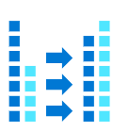
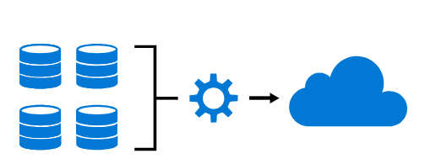
Azure Data Factory
Hybrid data integration service for enabling code-free ETL
Industry leading data ingestion
Visual
No Code
Hybrid
Pay only for what you use
Managed SSIS
Productive & trusted hybrid data integration service that simplifies ETL with any data, from any source, at scale.

Slide 27
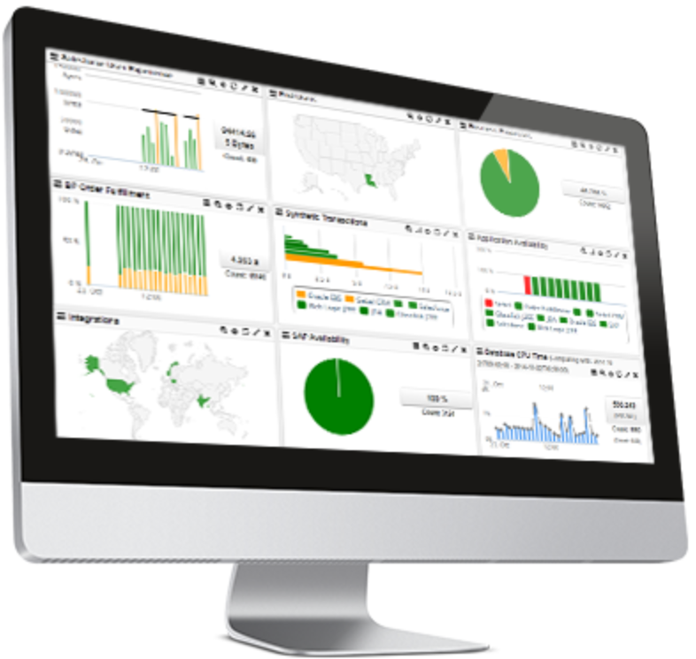




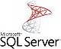









Command and Control
Data
Data Factory
A data integration account.
Location of orchestration, service metadata
UX & SDK
Authoring | Monitoring/Mgmt
Azure Data Factory v2 Service
Scheduling | Orchestration | Monitoring
Integration Runtime (IR)
ADF’s execution engine
Azure Integration Runtime
Self-Hosted Integration Runtime
SSIS Integration Runtime
Three core capabilities:
data movement
pipeline activity execution
SSIS package execution
Pipeline
SSIS Package
Self Hosted
Integration Runtime
Azure
Integration
Runtime
Azure Svcs
On Prem Apps & Data
Cloud & SaaS

Slide 28



Orchestration @ Scale
Trigger
Pipeline
foreach (…)
On demand
Schedule
Data Window
Event
Activity
Activity
Activity
Activity
Activity
Self-hosted
Integration Runtime
Azure
Integration Runtime
Linked
Service
LEGEND
On-prem
Apps & Data
Azure Services
Command and Control
Data

Slide 29
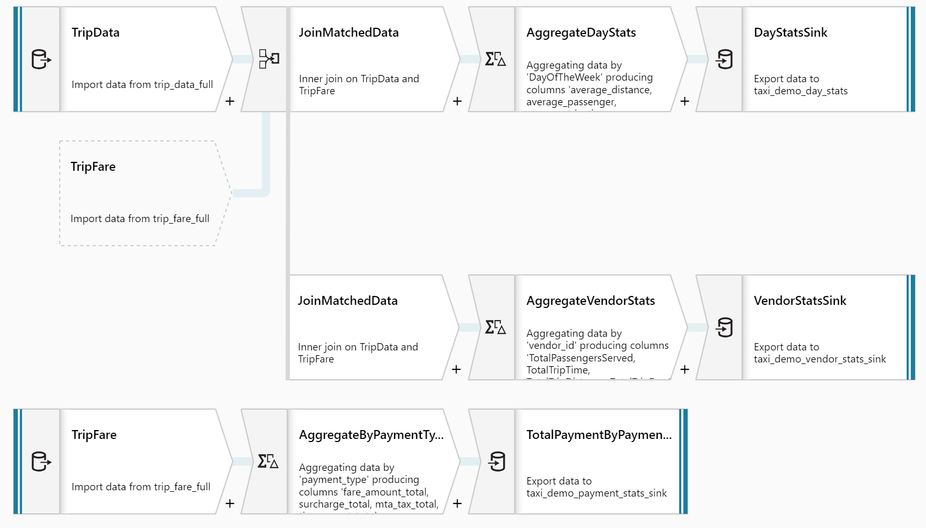
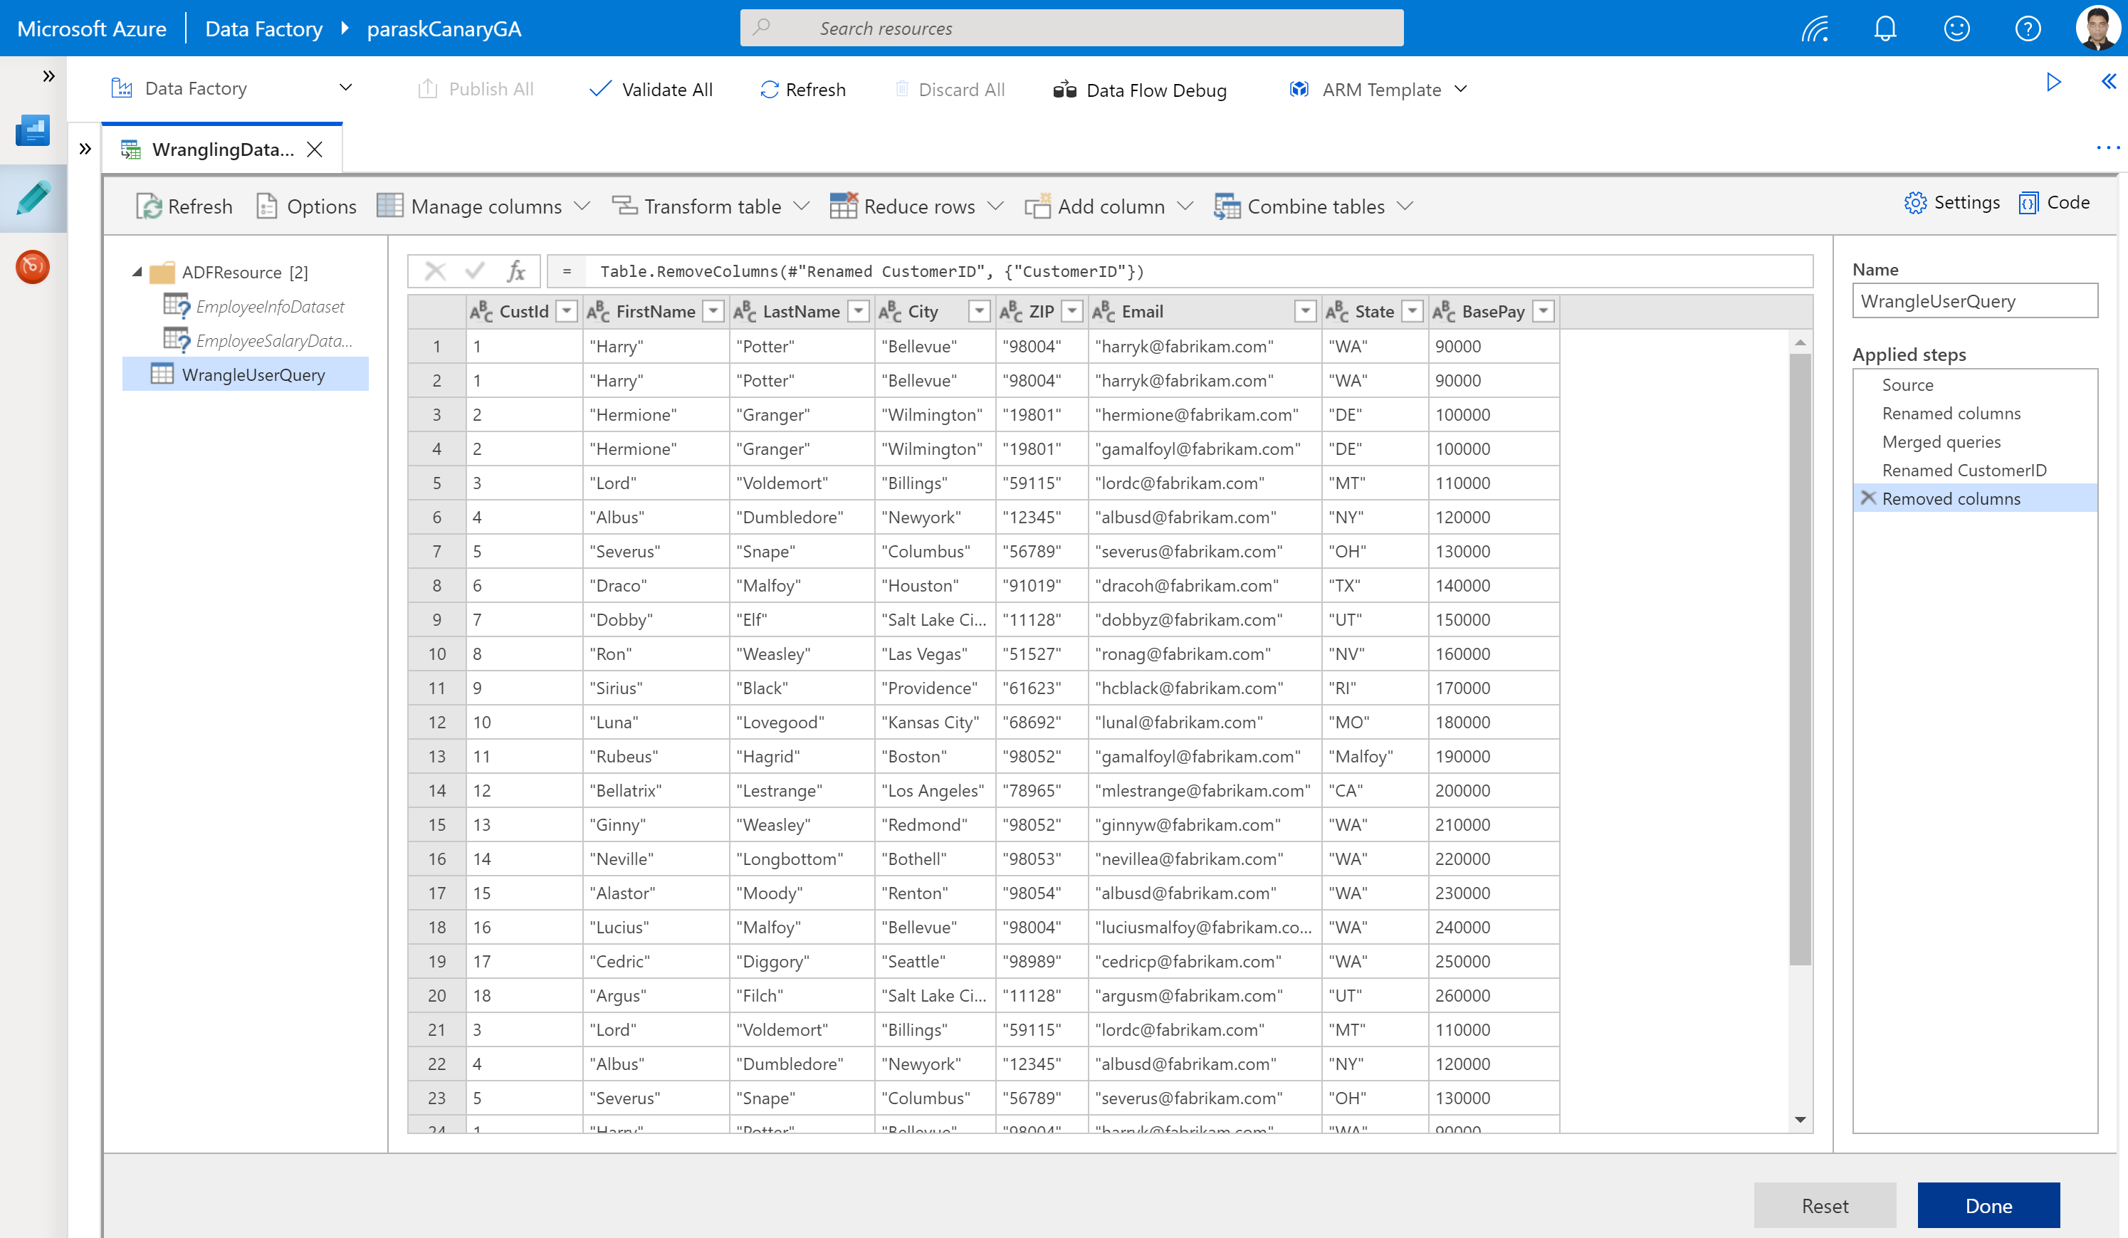
Azure Data Factory Data Flows
No-code data transformation and preparation @ scale
Mapping Dataflow
Code free data transformation @scale
Wrangling Dataflow
Code free data preparation @scale

Slide 30
Azure Data Lake Storage Gen2

Slide 31
The Modern Data Problem
Velocity
Real-time
Volume
How to derive value from data:
What happened historically?
What is happening now?
What is going to happen?
ZB
Batch
GB
Structured data
Each dimension of data is constantly expanding
Unstructured data
Variety

Slide 32
What is a Data Lake?
It is a central storage repository that holds data coming from many sources in a raw, granular format. It can store structured, semi-structured, or unstructured data, which means data ingested quickly and can be kept in a more flexible format for future use cases.
Characteristics
Schema-on-read (ELT)
Collection of data, not a platform
Benefits
Quickly ingest high volumes of diverse data structures
Enable advanced analytics and data exploration
Scalability and storage cost reduction
Best Practices
Data Governance needed to avoid Data Swamp
Security considerations
Perfect place for evolving data
Design your Data Lake
Metadata management
Notes:
Characteristics

Slide 33
Data Warehouse or Data Lake?
Answer: both.
 | Data Warehouse | Data Lake
Requirements | Relational requirements | Diverse data, scalability, low cost
Data Value | Data of recognised high value | Candidate data of potential value
Data Processing | Mostly refined calculated data | Mostly detailed source data
Business Entities | Known entities, tracked over time | Raw material for discovering entities and facts
Data Standards | Data conforms to enterprise standards | Fidelity to original format and condition
Data Integration | Data integration upfront | Data prep on demand
Transformation | Data transformed, in principle | Data repurposed later, as needs arise
Schema Definition | Schema-on-write | Schema-on-read
Metadata Management | Metadata improvement | Metadata developed on read

Slide 34
Data Lake Design Considerations
Data Lake Zones
Transient Landing Zone
Temporary storage of data to meet regulatory and quality control requirements. Limited access. May not be required depending on requirements.
Raw Zone
Original source of data ready for consumption. Metadata publicly available but access to data still limited.
Trusted Zone
Standardized and enriched datasets ready for consumption to those with appropriate role-based access. Metadata available to all.
Curated/Refined Zone
Data transformed from Trusted Zone to meet specific business requirements.
Sandbox Zone
Playground for Data Scientists for ad hoc exploratory use cases.
Data Governance Considerations
Security and Compliance
Access Control at Folder/File level
Encryption at rest
Metadata Management
Data Quality
Metadata Management
Lifecycle Management

Slide 35
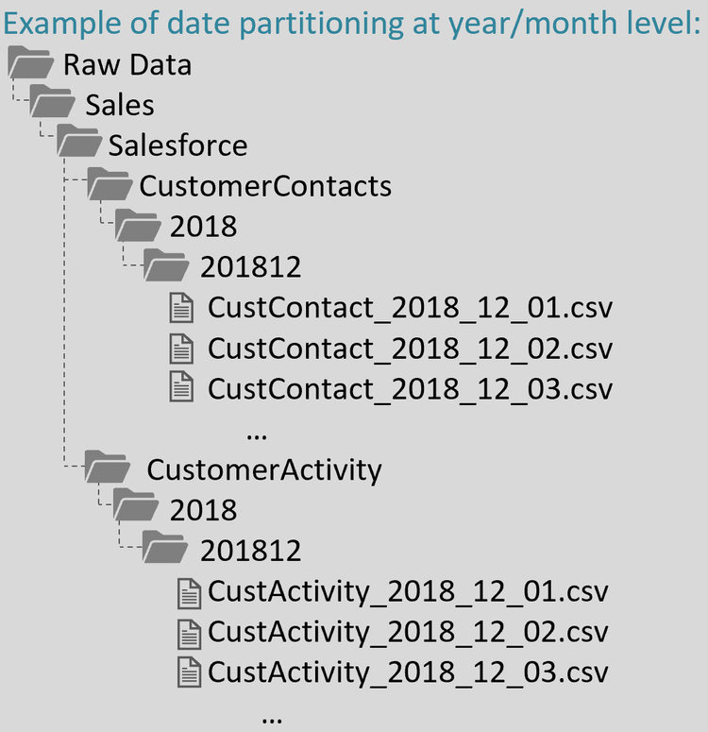
Data Lake Design Example
Data Lake Zone
Business Area
Source System
Entity Name
Year
Month
Data Files (standard naming convention)
Source: https://www.sqlchick.com/entries/2019/1/20/faqs-about-organizing-a-data-lake

Slide 36




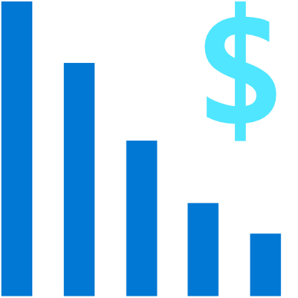

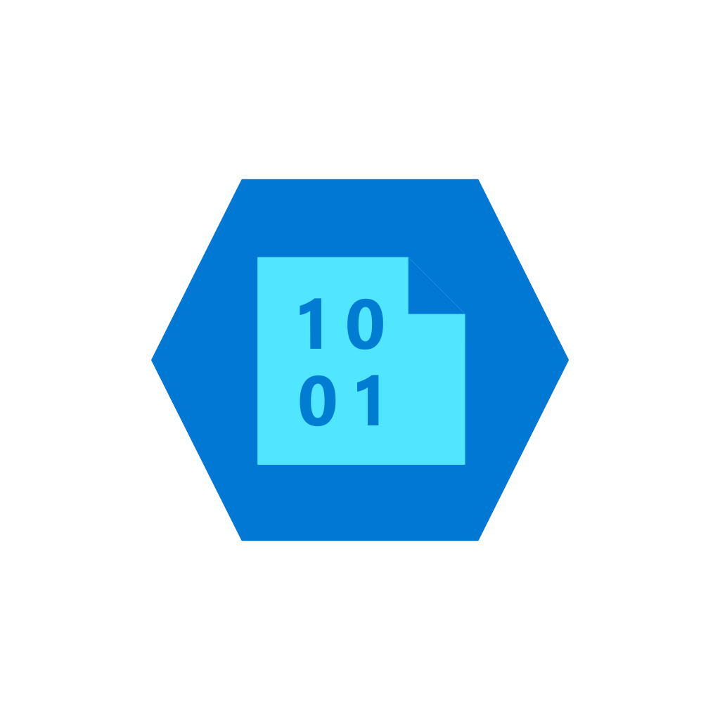
Azure Data Lake Storage Gen2
A “no-compromises” Data Lake: Secure, performant and massively-scalable
A Data Lake that brings together the cost and scale of object storage with the performance and analytics feature set of data lake storage
Fast
Manageable
Secure
Scalable
Cost effective
Integration ready
Atomic file operations mean jobs complete faster
Automated Lifecycle Policy Management
Object Level tiering
Support for fine-grained ACLs, protecting data at the file and folder level
Multi-layered protection via at-rest Storage Service encryption & Azure Active Directory integration
No limits on data store size
Global footprint (50 regions)
Object store pricing levels
File system operations minimize transactions required for job completion
Optimized for Spark and Hadoop Analytic Engines
Tightly integrated with Azure end to end analytics solutions
Multiprotocol access
+
Single service

Slide 37

Azure Data Lake Storage Gen2
High performance HDFS Endpoint to Azure Blob Storage
ADLS Gen2 API
Blob API
Hierarchical file system
File Data
Hadoop Filesystem, File and Folder Hierarchy, Granular ACLs
Unstructured Object Data
Server Backups, Archive Storage, Semi-structured Data
Security
Performance
Scale and cost effectiveness
Common Blob storage foundation
Common SDK, Tools, Control Plane
Object Tiering and Lifecycle Policy Management
AAD integration, RBAC, Storage account security
HA/DR support through ZRS and RA-GRS

Slide 38
Real-time Analytics

Slide 39
Real-time analytics
Deals with streams of data that are captured in real-time and processed with minimal latency to generate real-time (or near-real-time) reports or automated responses.
SQL
Modern data warehousing
Advanced analytics
Real-time analytics
“We want to integrate all our data—including Big Data—with our data warehouse”
“We’re trying to predict when our customers churn”
“We’re trying to get insights from our devices in real-time”

Slide 40







Streaming Use Cases
Retail
Financial
Oil/Gas & Energy
Security
CONSUMER ENGAGEMENT
RISK AND REVENUE MANAGEMENT
GRID OPS, ASSET OPTIMIZATION
ACTIONABLE THREAT INTELLIGENCE
Real-time Pricing Optimization
Risk and Fraud, Threat Detection
Industrial IoT
Security Intelligence
Demand-Elasticity
Personal Pricing Schemes
Promotion events
Multi-channel engagement
Real-time anomaly detection
Card Monitoring and Fraud Detection
Risk Aggregation
Preventive Maintenance
Smart Grids and Microgrids
Asset performance as a Service
UAV image analysis
Real-time firewall, network, and auth log correlation
Anomaly detection
Security context, enrichment
Security Orchestration
Healthcare
Advertising
Media Entertainment
SENSOR DATA
RECOMMENDATION ENGINE
CONSUMER ENGAGEMENT ANALYSIS
And Much More!
IoT DEVICE
ANALYTICS
Next Best and Personalized Offers
Sentiment Analysis
Aggregation of streaming events
Predictive Maintenance
Anomaly Detection
Right product, promotion, at right time
Real time Ad bidding platform
Personalized Ad Targeting
Demand-Elasticity
Social Network Analysis
Promotion events
Multi-channel Attribution

Slide 41

Unlocking Real-time Insights
Time to Insight is Critical
Reducing decision latency can unlock business value
Insights are Perishable
Window of opportunity for insights to be actionable
Ask Questions to Data in Motion
Can’t wait for data to get to rest before running computation

Slide 42

Real-time Stream Processing
Simple Event Processing
Filter
Transform
Enrich
Split
Route
Event Stream Processing
[Simple event processing] +
Aggregate
Rules
Complex Event Processing
[Event Stream Processing] +
Pattern detection
Time windows
Joins & correlations

Slide 43
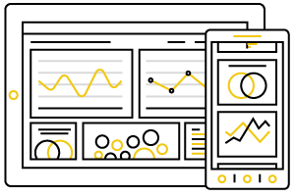
Scenario Types
Actions by Human Actors
“See and seize” insights
Live visualization
Alerts and alarms
Dynamic aggregation
Machine to Machine Interactions
Data movement with enrichment
Kick-off workflows for automation
Dashboarding
Automation
Enriched Data Movement

Slide 44
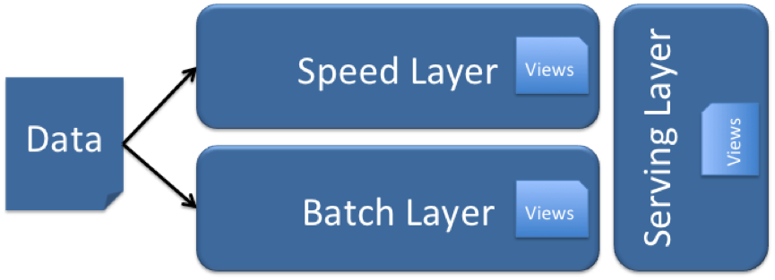
Lambda (λ) Architecture
Designed to handle Big Data use cases by taking advantage of both batch and stream-processing methods
All data entering the system is dispatched to both the batch layer and the speed layer for processing.
The batch layer has two functions:
manage the master dataset (an immutable, append-only set of raw data)
pre-compute the batch views.
The serving layer indexes the batch views so that they can be queried in low-latency, ad-hoc way.
The speed layer compensates for the high latency of updates to the serving layer and deals with recent data only.
Any incoming query can be answered by merging results from batch views and real-time

Slide 45
Event Hubs

Slide 46
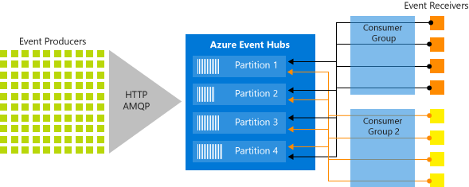
Event Hubs
Big data streaming platform and event ingestion service capable of receiving and processing millions of events per second.

Slide 47
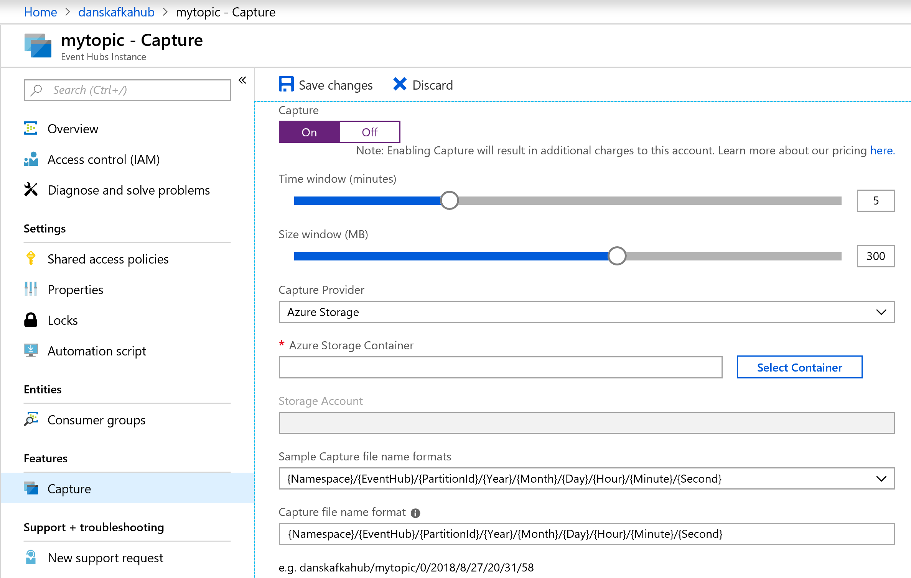
Event Hubs Capture
Batch on stream
Policy based push to your own storage
Uses Avro format
Raises Event Grid events – connect to Functions, ACI, or whatever you like
Does not impact throughput
Offloads batch processing from your real-time stream

Slide 48
Stream Analytics

Slide 49
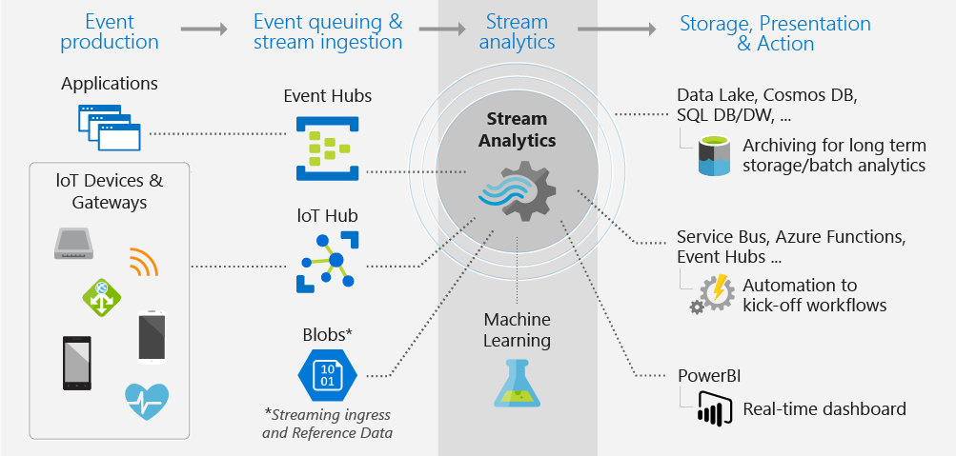
Stream Analytics
Event-processing engine that allows you to examine high volumes of data streaming from devices

Slide 50
Differentiators
1,915 lines of code with Apache Storm
Programmer Productivity
Declarative SQL like language
Built-in temporal semantics
Ease of Getting Started
Integrations with sources, sinks, & ML
Build real-time dashboards in minutes
Lowest Total Cost of Ownership(TCO)
Fully managed service
No cluster topology management required
Seamless scalability
Usage based pricing
@ApplicationAnnotation(name="WordCountDemo")
public class Application implements StreamingApplication
{
protected String fileName = "com/datatorrent/demos/wordcount/samplefile.txt";
private Locality locality = null;
@Override public void populateDAG(DAG dag, Configuration conf)
{
locality = Locality.CONTAINER_LOCAL;
WordCountInputOperator input = dag.addOperator("wordinput", new WordCountInputOperator());
input.setFileName(fileName);
UniqueCounter<String> wordCount = dag.addOperator("count", new UniqueCounter<String>());
dag.addStream("wordinput-count", input.outputPort, wordCount.data).setLocality(locality);
ConsoleOutputOperator consoleOperator = dag.addOperator("console", new ConsoleOutputOperator());
dag.addStream("count-console",wordCount.count, consoleOperator.input);
}
}
3 lines of SQL in Azure Stream Analytics
SELECT Avg(Purchase), ScoreTollId, Count(*)
FROM GameDataStream
GROUP BY TumblingWindows(5, Minute), Score

Slide 51
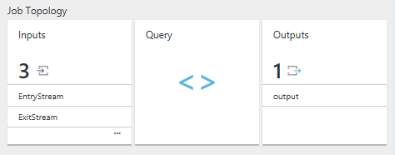
Stream Analytics Job
Users construct and deploy jobs to Azure Stream Analytics
Job definition includes inputs, a query, and output
Inputs are from where the job reads the data stream
Query runs for perpetuity unless explicitly stopped and transforms the input stream
Output is where the job sends the job results to

Slide 52
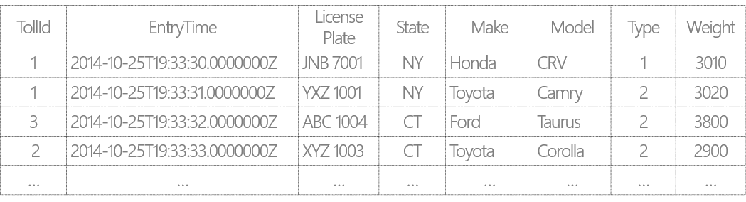
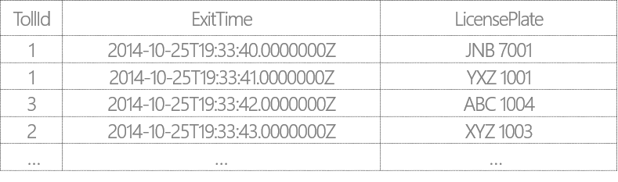
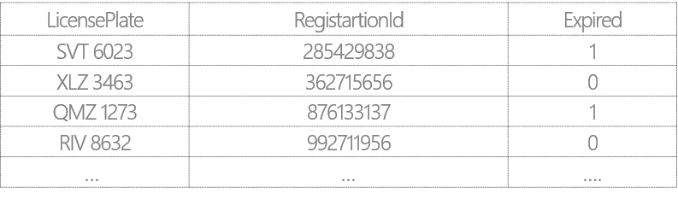
Example Scenario: Tolling Stations
Tolling stations have multiple booths (identified by TollId)
Each booth has two sensors: Entry and Exit that send out EntryStream and ExitStream respectively
EntryStream – Data stream from the Entry sensor data on vehicles entering toll booths
ExitStream - Data stream from the Exit sensor on vehicles exiting toll booths
ReferenceData - Commercial vehicle registration data

Slide 53
Filters and Projections
SELECT VehicleCategory =
Case Type
WHEN 1 THEN ‘Passenger’
WHEN 2 THEN ‘Commercial’
ELSE THEN ‘Other’
END,
TollId,
LicensePlate,
State,
Make,
Model,
DATEPART(mi,EntryTime) AS ‘Mins’,
DATEPART(ss,EntryTime) AS ‘Seconds’
DATEPART(ms,EntryTime) AS ‘Milleseconds’
FROM EntryStream TIMESTAMP BY EntryTime
WHERE (State = ‘CA’ OR State = ‘WA’)
AND Weight < 3000
AND CHARINDEX (‘M’, model) = 0
AND PATINDEX(‘%999’, LicensePlate) = 5
From the incoming stream find only vehicles that:
Are from either WA and CA state
Have a weight less than 3000 lbs
Have License plate number end in 999
Have a make that starts with a “M”
Display:
“Passenger” if type = 1
“Commercial” if Type = 2
“Other” for all other types
Display time as ‘Mins’, ‘Seconds’, ‘Milliseconds’

Slide 54
Temporal Joins
Report the time in seconds required for vehicles to pass the toll booth
SELECT ES.TollId,
ES.EntryTime,
EX.ExitTime,
ES.EntryTime,
ES.LicensePlate DATEDIFF(minute, ES.EntryTime, EX.ExitTime )
FROM EntryStream ES TIMESTAMP BY EntryTime
JOIN ExitStream EX TIMESTAMP BY ExitTime
ON (EX.TollId= ES.TollId and ES.LicensePlate = EX.LicensePlate)
AND DATEDIFF(minute, ES, EX) BETWEEN 0 AND 15

Slide 55
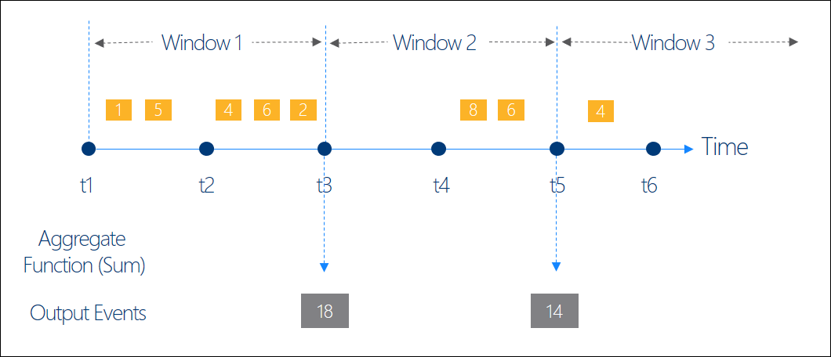
Windowing Concepts
Operations on the data contained in temporal windows is a common pattern
Four types of Temporal Windows:
Sliding
Tumbling
Hopping
Session
Output at the end of each window
Windows are fixed length
Used in a GROUP BY clause

Slide 56
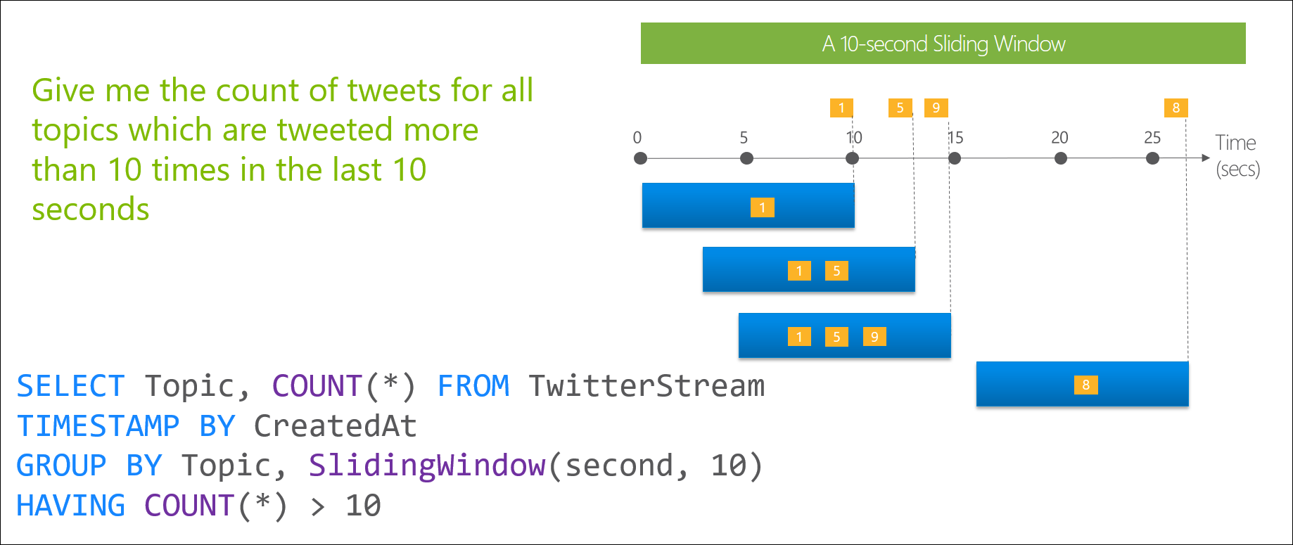
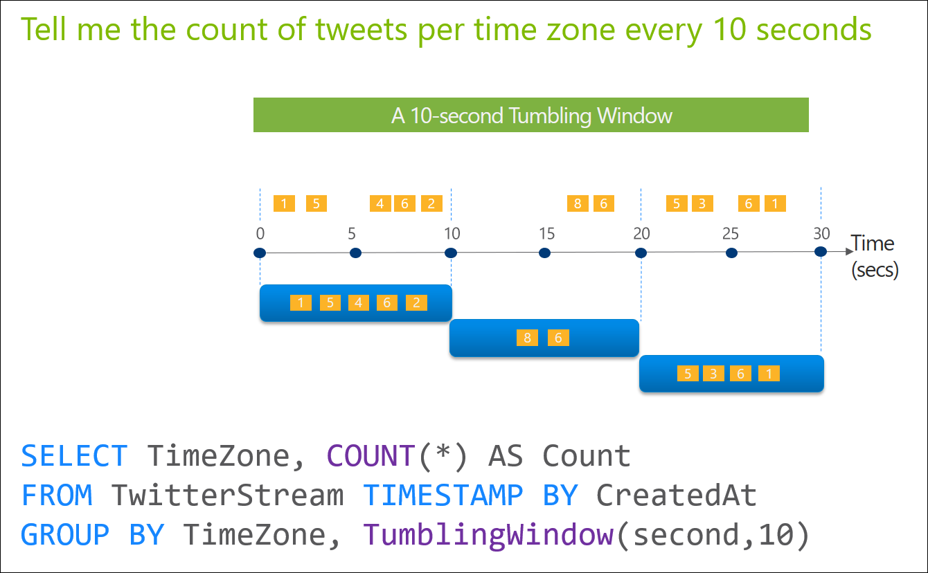
Windowing Functions
Sliding Windows and Tumbling Windows
Sliding Windows
Tumbling Windows

Slide 57
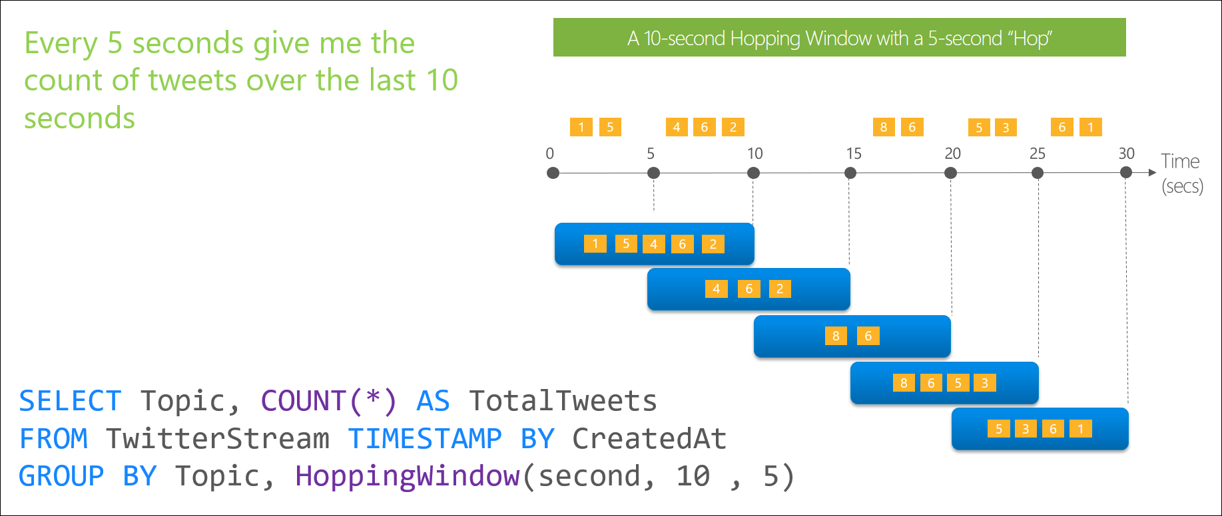
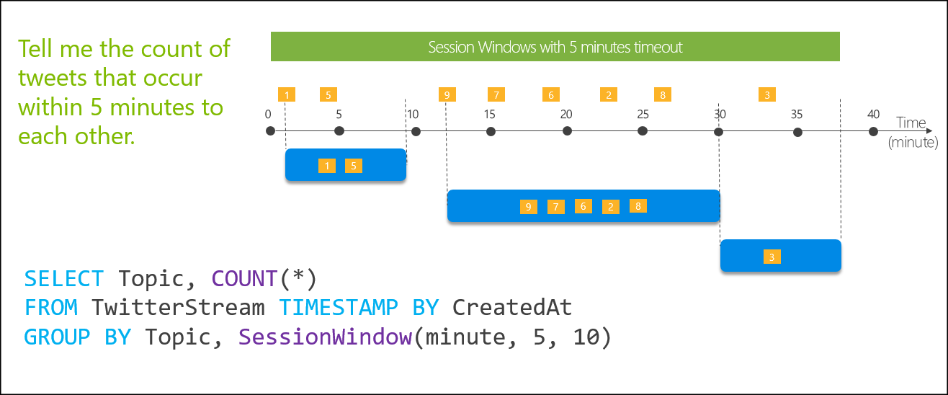
Windowing Functions
Hopping Windows and Session Windows
Hopping Windows
Session Windows

Slide 58
Lab 5: Ingest and Analyse real-time data with Event Hubs and Stream Analytics

Slide 59
Lab 5
Ingest and Analyse real-time data with Event Hubs and Stream Analytics

Slide 60
Lab 5
Lab Architecture

Slide 61
It’s all on
Notes:
With Azure, you can be more productive. Azure has more than 100 services with great end-to-end tools to make you successful.
Develop and deploy where you want, with the only consistent hybrid cloud on the market. Extend Azure on-premises with Azure Stack.
Create intelligent apps using powerful data and AI services.
Develop with confidence on the trusted cloud.
<Transition>: Join startups, governments, and 90% of Fortune 500 businesses who run on the Microsoft Cloud today.

